Slide 1
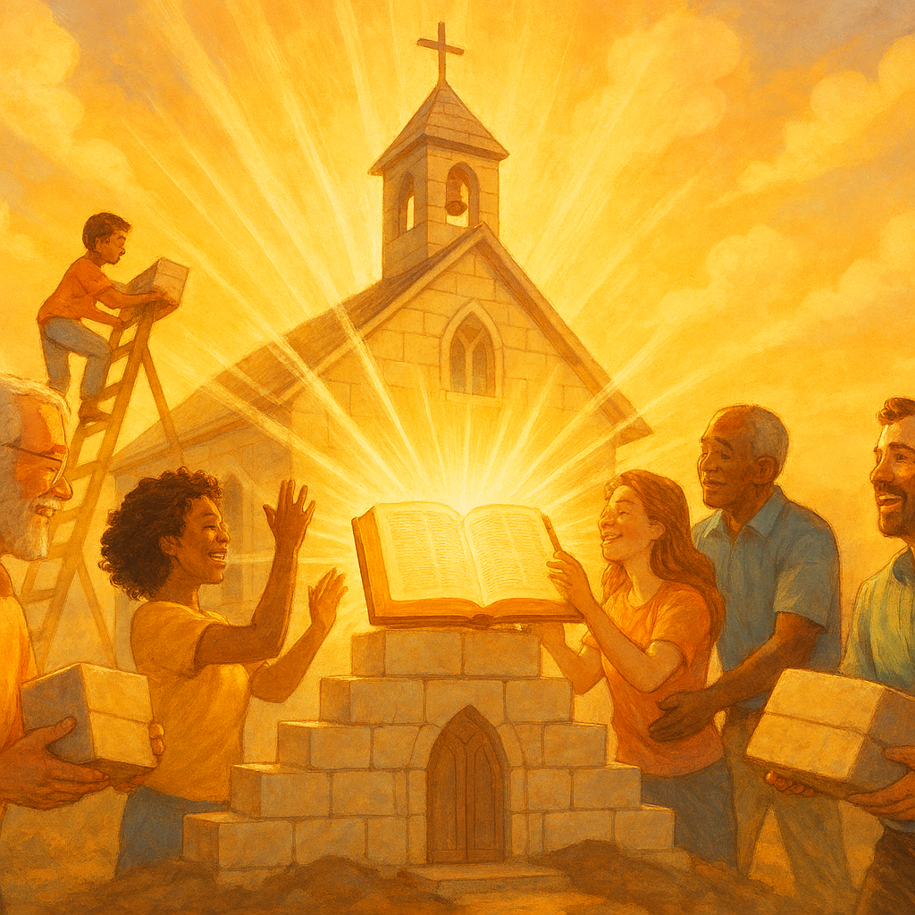
Glorifying GOD by Loving and Building Christ’s Church
Scripture
I Corinthians 10:31
Notes:
Eddie Williams ~ March 15, 2026

Slide 2
I Corinthians 10:31 (NLT)
So whether you eat or drink or whatever you do, do it all for the glory of God.

Slide 3
1 Corinthians 10:31 teaches that every action, no matter how routine, should honor God. It means acting with gratitude, recognizing Him as the provider, and ensuring actions, including eating, reflect love and obedience rather than selfishness or excess.
Key Aspects of this Command include:

Slide 4
1) Intention:
Even mundane, everyday activities like eating and drinking can be used to glorify God.

Slide 5
2) Gratitude:
Acknowledging God as the source of daily sustenance and expressing thanks.

Slide 6
3) Lifestyle:
Extending this principle to all actions (work, speech, behavior) to ensure they align with His will.

Slide 7
4) Self-Examination:
It serves as a test for conduct.
If an act cannot be done for His glory, it should be avoided.

Slide 8
GOD WANTS EVERY MEMBER OF HIS BODY TO BUILD THE CHURCH USING THE GIFT HE GAVE US
To Bring HIM Glory

Slide 9
Ephesians 4:10-16 (NASB)
¹⁰ He who descended is Himself also He who ascended far above all the heavens, so that He might fill all things.) ¹¹ And He gave some as apostles, some as prophets, some as evangelists, some as pastors and teachers,

Slide 10
Ephesians 4:10-16 (NASB)
¹² for the equipping of the saints for the work of ministry, for the building up of the body of Christ;
¹³ until we all attain to the unity of the faith, and of the knowledge of the Son of God, to a mature man,

Slide 11
Ephesians 4:10-16 (NASB)
to the measure of the stature which belongs to the fullness of Christ.
¹⁴ As a result, we are no longer to be children, tossed here and there by waves and carried about by every wind of doctrine,

Slide 12
Ephesians 4:10-16 (NASB)
by the trickery of people, by craftiness in deceitful scheming; ¹⁵ but speaking the truth in love, we are to grow up in all aspects into Him who is the head, that is, Christ,

Slide 13
Ephesians 4:10-16 (NASB)
¹⁶ from whom the whole body, being fitted and held together by what every joint supplies, according to the proper working of each individual part, causes the growth of the body for the building up of itself in love.

Slide 14
God’s perfect design for Church growth is every member growing to be perfect (mature) doing what the HOLY SPIRIT has given you to do, using the gift he gave us.

Slide 15
I Corinthians 12:12-26 (NASB)
¹² For just as the body is one and yet has many parts, and all the parts of the body, though they are many, are one body, so also is Christ. ¹³ For by one Spirit we were all baptized into one body, whether Jews or Greeks, whether slaves or free,

Slide 16
I Corinthians 12:12-26 (NASB)
and we were all made to drink of one Spirit. ¹⁴ For the body is not one part, but many. ¹⁵ If the foot says, "Because I am not a hand, I am not a part of the body," it is not for this reason any less a part of the body.

Slide 17
I Corinthians 12:12-26 (NASB)
¹⁶ And if the ear says, "Because I am not an eye, I am not a part of the body," it is not for this reason any less a part of the body.
¹⁷ If the whole body were an eye, where would the hearing be?

Slide 18
I Corinthians 12:12-26 (NASB)
If the whole body were hearing, where would the sense of smell be? ¹⁸ But now God has arranged the parts, each one of them in the body, just as He desired. ¹⁹ If they were all one part, where would the body be?

Slide 19
I Corinthians 12:12-26 (NASB)
²⁰ But now there are many parts, but one body. ²¹ And the eye cannot say to the hand, "I have no need of you"; or again, the head to the feet, "I have no need of you."

Slide 20
I Corinthians 12:12-26 (NASB)
²² On the contrary, it is much truer that the parts of the body which seem to be weaker are necessary; ²³ and those parts of the body which we consider less honorable, on these we bestow greater honor,

Slide 21
I Corinthians 12:12-26 (NASB)
and our less presentable parts become much more presentable, ²⁴ whereas our more presentable parts have no need of it. But God has so composed the body, giving more abundant honor to that part which lacked,

Slide 22
I Corinthians 12:12-26 (NASB)
²⁵ so that there may be no division in the body, but that the parts may have the same care for one another. ²⁶ And if one part of the body suffers, all the parts suffer with it; if a part is honored, all the parts rejoice with it.

Slide 23
If a Child of GOD is Not Striving to Understand and Use His GIFT,
Is He Glorifying GOD?

Slide 24
Luke 6:46 (NASB)
"Now why do you call Me, 'Lord, Lord,' and do not do what I say?

Slide 25
Matthew 7:21-23 (NASB)
²¹ "Not everyone who says to Me, 'Lord, Lord,' will enter the kingdom of heaven, but the one who does the will of My Father who is in heaven will enter.

Slide 26
Matthew 7:21-23 (NASB)
²² "Many will say to Me on that day, 'Lord, Lord, did we not prophesy in Your name, and in Your name cast out demons, and in Your name perform many miracles?'

Slide 27
Matthew 7:21-23 (NASB)
²³ "And then I will declare to them, 'I never knew you; LEAVE ME, YOU WHO PRACTICE LAWLESSNESS.'

Slide 28
James 1:22 (NASB)
But prove yourselves doers of the word, and not just hearers who deceive themselves.

Slide 29
Romans 2:13 (NASB)
for it is not the hearers of the Law who are righteous before God, but the doers of the Law who will be justified.

Slide 30
Titus 1:16 (NASB)
They profess to know God, but by their deeds they deny Him, being detestable and disobedient and worthless for any good deed.

Slide 31
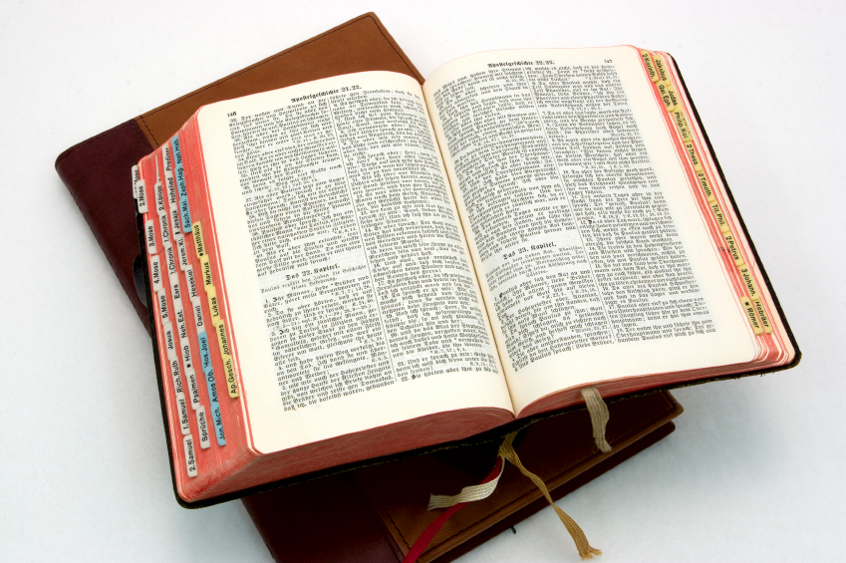
Hear: Romans 10:17
So then faith cometh by hearing, and hearing by the word of God.

Slide 32
Believe: Hebrews 11:6
But without faith it is impossible to please him: for he that cometh to God must believe that he is, and that he is a rewarder of them that diligently seek him.

Slide 33
Repent: Luke 13:3
I tell you, Nay: but, except ye repent, ye shall all likewise perish.

Slide 34
Confess: Matthew 10:32-33
32 Whosoever therefore shall confess me before men, him will I confess also before my Father which is in heaven.
33 But whosoever shall deny me before men, him will I also deny before my Father which is in heaven.

Slide 35
Baptize: Acts 22:16
And now why tarriest thou? arise, and be baptized, and wash away thy sins, calling on the name of the Lord.

